Slide 1
Buying IT – DIR Contract Briefing
SHERRI PARKS
Director
Contracting & Procurement Services Division

Slide 2
ICT Cooperative Contracts
WHAT DO THEY DO?
  Create savings for taxpayers by aggressively leveraging the state’s buying power to lower prices and obtain best value
  Optimize the purchase of ICT commodities and services
    Streamlines process for customers
      Reduces duplicate efforts – all contracts competitively procured
      Reduces purchasing and contract cycle time – issue P.O. directly to the DIR vendor
    Simplifies the sales process for vendors
  Include ICT commodity items as contracted product offerings
    Hardware and software
    Technology staffing services
    Other ICT services with high customer demand (seat management, technology training, etc.)
    Maintenance

Slide 3
ICT Cooperative Contracts - Statistics
381 Cooperative Contracts
  266 Total Resellers
  121 HUB Prime Vendors
  121 HUB Resellers
38% growth in the last 2 years (FY05-06)
Over $1 billion projected for FY08
Customer Base
  Market Segmentation Analysis
    53% Education
    23% Local Government
    24% State Agencies
ICT Cooperative Contract Sales

Slide 4
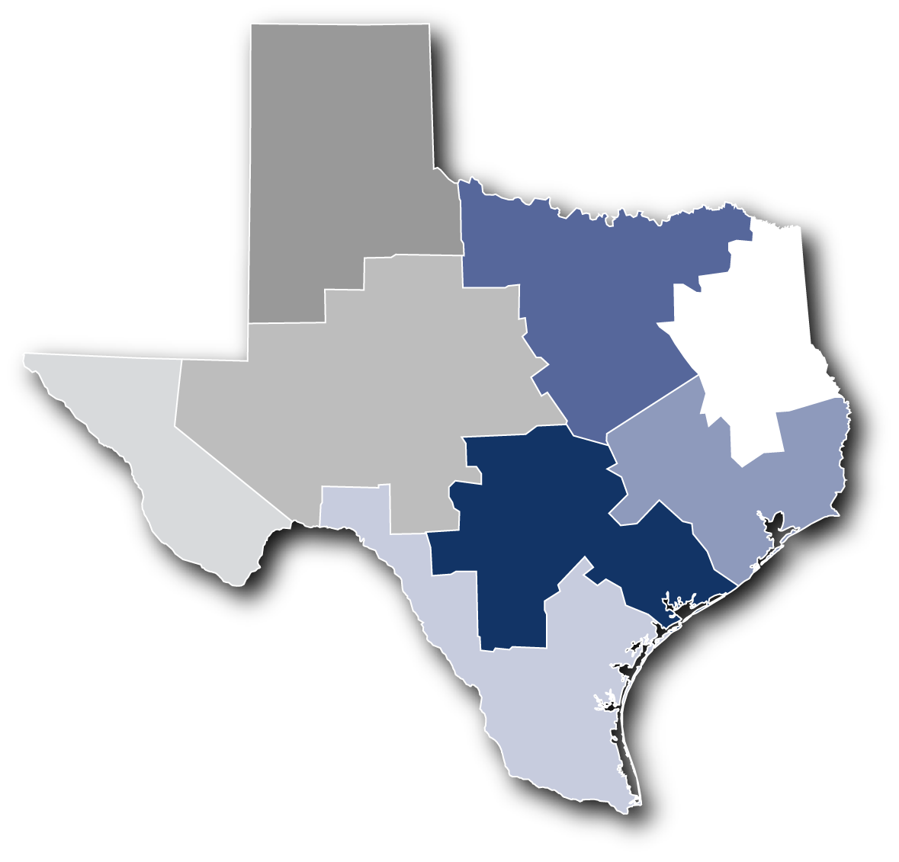
Where Are DIR’s Customers Located?
REGIONAL DISTRIBUTION OF FY07 SALES
Reg. 5
$34 M
*Telecommunications Go DIRect
sales of $73 M were distributed to regions via pro-rated percentage of sales.
Reg. 2
$219 M
Reg. 8
$21 M
Reg. 7
$24 M
Reg. 1
$200 M
Reg. 6
$24 M
Reg. 3
$392 M
Reg. 4
$79 M

Slide 5
Available Products
Computers – over 20 brands
Software – over 1000 publisher titles
Networking Equipment – over 100 brands
Printers – over 25 brands
Surveillance Cameras – over 60 brands - new product offering
Data Storage – over 20 brands
Digital Photography
Projectors
Security Products
Videoconferencing Equipment
Classroom Interactive Products – new product offering
Graphing Calculators

Slide 6
Available Services
IT Staffing Services – over 170 vendors
Training – Instructor Led and Computer Based
Seat Management – 7 vendors
Managed Document Output – 4 vendors
Disaster Recovery
Telecommunications Services including:
    Wireless Voice and Data
    Pagers
    Local Telephone Service
    Long Distance
    Internet
    Satellite
    Video
    Interpreter Services – over the phone
    Audio Conferencing
    Cable Modem and DSL

Slide 7
New Contract Offerings
Seat Management
Wireless Voice and Data
IT Staffing Services
Managed Document Output
Enterprise Architecture

Slide 8
Seat Management Highlights
  Not to Exceeds Rates
    Per seat pricing based on a standard configuration
    Allows for an apples to apples comparison
  Base Offering
    Basic asset tracking
    Break/Fix
    Engagement unwind
  Other Optional Services
    Help desk
    On-site and remote support
    Network management
    Software
    Asset tracking
    Training
    Reporting
  Service Level Agreements (SLAs)
    Provides three levels of SLAs; Bronze, Silver and Gold
    Allows for flexibility to meet individual agency needs
  Competition
    Customers should compete amongst the seven vendors
    Pursue volume discounts

Slide 9
Seat Management Highlights
  Awarded Vendors
    Compucom
    Dell
    IBM
    Lockheed Martin
    Northrop Grumman
    Unisys
    Vintage

Slide 10
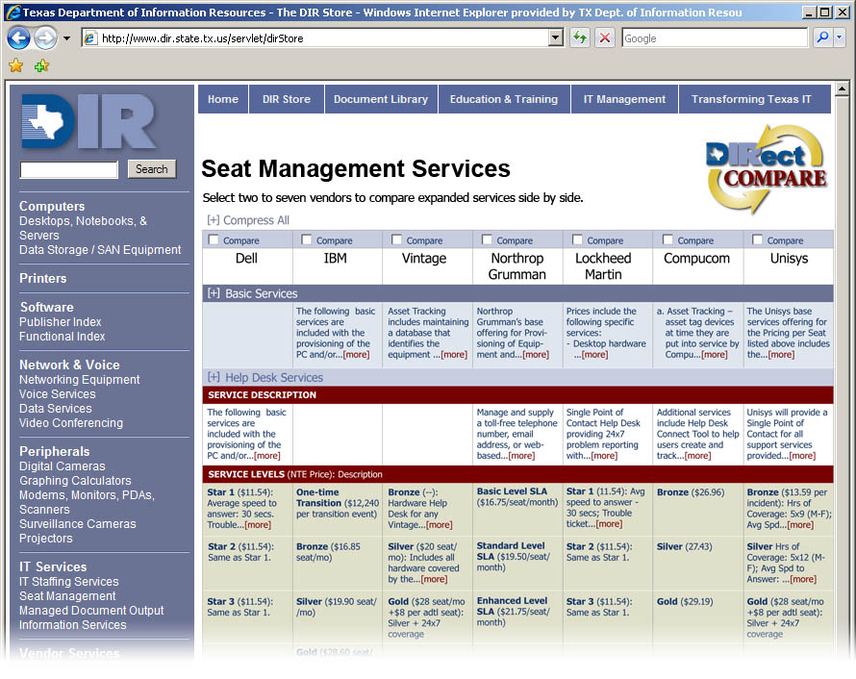
Seat Management DIRect Compare
GOAL
  Provide an easy-to-use technology tool to allow DIR customers to select the best contracting options to suit unique business needs

Slide 11
Wireless Highlights
Six Contracts Awarded
    Alltel
    Cellular One
    AT&T Mobility
    Sprint
    T-Mobile
    Verizon
All Activation and Termination charges waived, includes early termination charges
Government Mandated Fees (Cost Recovery, Federal Universal Service Fund (FUSF), etc.)
    Alltel, AT&T Mobility, Cellular One, T-Mobile waived all fees
    Sprint and Verizon waived all fees except FUSF and E911
    Savings of over $1.2 Million over the life of the contracts
Quarterly Customer Satisfaction Scores

Slide 12
Staffing Services Highlights
  Stimulated Competition
    Initial solicitation – Established not to exceed rates
    Individual work orders provide for further competition
  Instituted a Performance-based Metric-driven Program
    Quarterly assessments of vendor performance
    Third quarter metrics just released
    Vendor promotions and demotions based on quantitative and qualitative measures
    Two consecutive quarters of an unsatisfactory rating result in a suspension of the vendor’s contract
  Frequent Opportunities for New Vendors
    Rebid conducted in December 2007
    Only new vendors needed to respond

Slide 13
Managed Document Output Services Highlights
  Comprehensive method to identify and service imaging equipment
  Equipment supported includes:
    Printers
    Copiers
    Faxes
    Scanners
    Multifunction units
  Services Include:
    Technical Discovery
    Asset tracking
    Support services of leased or owned equipment
    Help desk
    Training
    Installation
    Move/Adds/Changes
    Reporting
    Consumables for equipment supported
  Awarded Vendors
    Hewlett Packard
    Lexmark
    Okidata
    Xerox

Slide 14
Enterprise Architecture Highlights
  Customer Focus Groups
    Held in 2006
    Identified initial set of high priority functional areas
    Defined guideline for individual functional areas, statewide interoperability and security best practices
  Solicitation was based on functionality rather than Publisher
  Contracts awarded only for products that meet these guidelines
  Functional Index on DIR’s Website
    Search by functionality rather than just by Publisher name
    Operation in early FY08
  Awards are on-going
  Awarded contracts to date
    Adjacent Technologies eBusiness 1 Planview
    Alfresco EIS Pronto Solutions
    Athens Consulting Gravitant RFD & Associates
    BIF Technologies Info Builders Serena
    BlueCat Networks Intersystems Symantec
    Brookhaven Solutions MicroStrategy Tokairo
    CDWG NetQoS Troux Technologies
    Compucom Orion Communications Unisys

Slide 15
Future Contracting Opportunities
CURRENT CONTRACTING INITIATIVES
  Posted on DIR’s Web site (www.dir.state.tx.us/store/cci)
  to improve communications between DIR vendors
  and customers
  Lists initiatives by procurement stage
    Planning
    RFO Postings: links directly to the posting on the ESBD
    Evaluation
    Negotiation
    Recent Award
  Each initiative has a brief description, expected phase completion date, and contact information

Slide 16
Current Contracting Initiatives - Planning
Stage | Type of Services/Products | Description | Start Date | RFO Release Date | Contact Person
Planning | Emergency Preparedness Hardware | Release RFO to contract with Vendor (s) to provide hardware and devices for the purpose of emergency preparedness | Nov 07 | Mar 08 | Stephanie Miller
Planning | Software Products | Rebid Software Products to allow opportunity for new vendors and products. Vendors with existing contracts will not need to rebid. | Jan-08 | Jun-08 | Grace Windbigler
Planning | Augmenting RFO to Surveillance Equipment and Services | Release RFO to augment surveillance equipment and services to add access controls such as card readers | Jan-08 | Apr-08 | Mark Howard
Planning | Computers | Release an RFO to provide statewide contracts for major manufacture lines of computers | Feb-08 | Apr-08 | Grace Windbigler
Planning | Website Design/Development & Hosting | Release RFO to contract with Vendor(s) to provide website design, development and hosting | Jan-08 | Apr-08 | Grace Windbigler

Slide 17
Current Contracting Initiatives - Planning Cont’d
Stage | Type of Services/Products | Description | Start Date | RFO Release Date | Contact Person
Planning | Mobile Police Video | Release RFO to contract with Vendor(s) to provide mobile video cameras for use in police vehicles. | Jan-08 | Mar-08 | Shannon Kelley
Planning | Networking Equipment | Rebid Networking Equipment to allow opportunity for new vendors and products. Vendors with existing contracts will not need to rebid. | Jan-08 | Mar-08 | Mark Howard
Planning | Telecommunications Parts and Supplies | Provide additional contracts in which to buy Telecommunications Parts and Supplies. | 02/0007 | Mar-08 | Shannon Kelley
Planning | Deliverables Based Contracting | Release RFO to pre-qualify vendors for IT projects and contracts in specific areas of expertise | Sep-07 | Feb-08 | Mary Cheryl Dorwart
Planning | Regulatory Licensing Software RFO | Release RFO to obtain regulatory software used by regulatory entities that perform licensing and regulation of professional occupations. The scope will include software licenses, implementation services, ongoing software maintenance, and technical support services. | Feb-06 | Feb-08 | Shannon Kelley
Planning | Technology-Based Conferencing | Release RFO to contract with Vendor(s) to provide technology to allow users to attend conference calls via audio, video and the Internet. Live Office Meetings and Webex are two primary vendors of these products/services. | Dec-07 | Feb-08 | Stephanie Miller
Planning | Technology-Based Training RFO | Release RFO to provide statewide contracts for technology based training. | Mar-06 | Feb-08 | Kerry Stennett

Slide 18
Current Contracting Initiatives - Posting / Evaluation
Stage | Type of Services/Products | Description | Start Date | RFO Release Date | Contact Person
RFO Posting | Technology Based Recording Equipment, Software and Services | Posted Request for Offer (RFO) DIR-SDD-TMP-111 | Jan 08, 2008 | Feb 14, 2008 | Denny Ross
Stage | Contract | RFO Number | Start Date | End Date | Contact Person
Evaluation | Emergency Preparedness Software | DIR-SDD-TMP-103 | July 13, 2007 | 1st Quarter 2008 | Denny Ross
Evaluation | IT Staffing Services | DIR-SDD-TMP-109 | January 10, 2008 | 3rd Quarter 2008 | Denny Ross

Slide 19
Current Contracting Initiatives - Negotiations
Stage | Contract | RFO Number | Start Date | End Date | Contact Person
Negotiation | Break/Fix Services | DIR-SDD-TMP-096 | 2/9/2007 | 2nd qtr 2008 | Denny Ross
Negotiation | Cabling Services | DIR-SDD-TMP-087 | 7/4/2007 | 1st qtr 2008 | Denny Ross
Negotiation | Computers | DIR-SDD-TMP-095 | Mar-07 | 1st qtr 2008 | Denny Ross
Negotiation | Court Case Management Software | DIR-SDD-TMP-101 | 6/1/2007 | 1st qtr 2008 | Denny Ross
Negotiation | Enterprise Architecture | DIR-SDD-TMP-076A | 8/31/2006 | 1st qtr 2008 | Denny Ross
Negotiation | Managed Services for Information Technology (a/k/a Seat Management Services) | DIR-SDD-TMP-091 | 1/23/2007 | 1st qtr 2008 | Denny Ross
Negotiation | Miscellaneous Information Technology (IT) Hardware Peripherals, Components, and Related Services | DIR-SDD-TMP-092 | 11/30/2006 | 2nd qtr 2008 | Denny Ross
Negotiation | Security Services | DIR-SDD-TMP-100 | 4/23/2007 | 3rd qtr 2008 | Denny Ross
Negotiation | Surveillance Cameras and Related Products and Services | DIR-SDD-TMP-082 | Apr-07 | 1st qtr 2008 | Denny Ross
Negotiation | Wireless Voice and Data Services and Equipment | DIR-SDD-TMP-089 | 5/24/2007 | 1st qtr 2008 | Denny Ross

Slide 20
Current Contracting Initiatives - Recent Awards
Stage | Contract | Vendor | Start Date | End Date | Contact Person
Recent Award | BMC Software Products and Related Services | Carasoft Technology Corporation | 8/22/2007 | 8/21/2008 | Denny Ross
Recent Award | Classroom Interactive Products, Systems and Related Services | CDW Government | 9/24/2007 | 9/24/2008 | Joanne Severn
Recent Award | Classroom Interactive Products, Systems and Related Services | Data Projections | 7/16/2007 | 7/16/2008 | Joanne Severn
Recent Award | Classroom Interactive Products, Systems and Related Services | Interwrite Learning | 10/4/2007 | 10/4/2008 | Joanne Severn
Recent Award | Classroom Interactive Products, Systems and Related Services | NCS Pearson | 7/16/2007 | 7/16/2008 | Joanne Severn
Recent Award | Classroom Interactive Products, Systems and Related Services | Smart Technologies | 11/20/2007 | 11/20/2008 | Joanne Severn
Recent Award | Classroom Interactive Products, Systems and Related Services | Visual Innovations | 9/28/2007 | 9/28/2008 | Joanne Severn
Recent Award | Oracle Peoplesoft Maintenance for State of Texas Enterprise Agreement | Oracle USA, Inc. | 7/18/2007 | 8/31/2008 | Denny Ross
Recent Award | Satellite Phones - Products and Services | GlobaFone, Inc. | 8/20/2007 | 8/19/2008 | Wayne Tatsch

Slide 21
Legislative Update - Effective September 1, 2007
HB 2918
  Repealed Catalog Information System Vendor (CISV) program
  Directed the Comptroller’s Office to adopt rules for IT purchasing
  Gave DIR the ability to enter into Multiple Award Schedules (TxMAS)

Slide 22
Legislative Update - Effective September 1, 2007
HB 2918
  Repealed Catalog Information System Vendor (CISV) program
    Customers may purchase IT Commodity items off of the DIR contracts by simply issuing a purchase order directly to the DIR contracted vendor.
    If the item is not available on a DIR contract, purchases should be made in accordance with the purchasing methods established by the Comptrollers office.
    Less confusion for the Vendor community
      CISV Vendor vs. DIR Vendor
      Separate website not required

Slide 23
Legislative Update - Effective September 1, 2007
HB 2918
  Directed Comptroller’s Office to adopt rules for IT Purchasing
    State Agencies purchase IT Commodity items off of the DIR contracts
    If the class/item code is not available on a DIR contract, purchases should be made via other procurement methods authorized by statute
      $0.00 - $5000 – May Spot Purchase
      $5000.01 - $25,000 – Formal quotes from at least 3 vendors based on written specifications
      $25,000.01 and above – Post formal bid on ESBD for at least 14 days
      Established new RFO process – preferred method
    IT Commodity Codes still marked with an asterisk on the CMBL- Automated Information System

Slide 24
Legislative Update - Effective September 1, 2007
HB 2918
  Gave DIR the authority to enter into Multiple Award Schedules (TxMAS)
    Transferred IT TxMAS, Schedule 70 contracts from TBPC to DIR
    Conducted review of all 130 contracts transferred
    Keeping approximately 10 contracts
      Will be amended
      Will be posted to the DIR website
    Others were terminated In November 2007
    New contracts on case by case basis

Slide 25
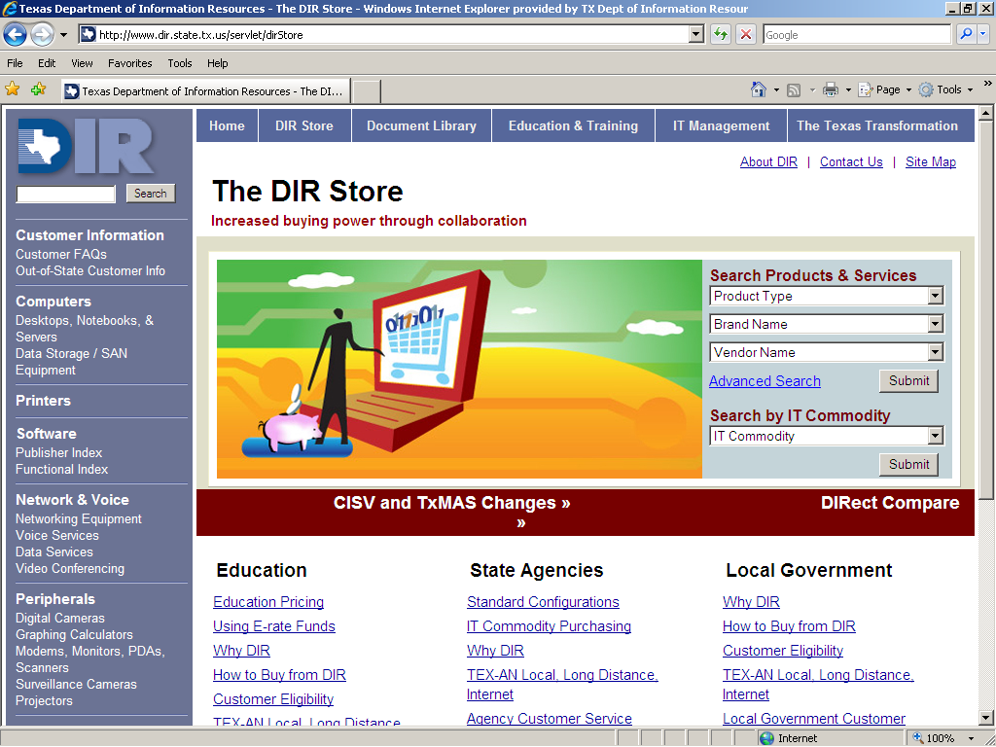
DIR Website
THE DIR STORE
  Provides searchable access to all Go DIRect contracts
  Provides valuable
  information for
  specific customer
  groups
  Describes the
  Go DIRect
  process in detail
  Gives access
  to current
  contracting
  initiatives

Slide 26
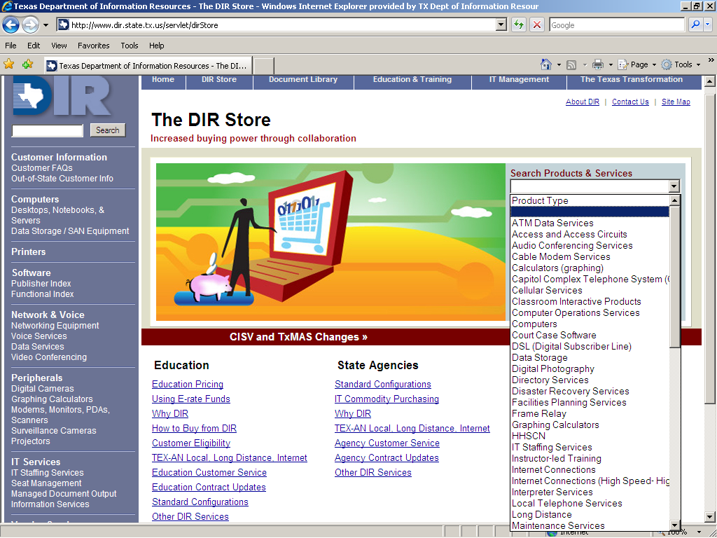
Searchable by Products & Services

Slide 27
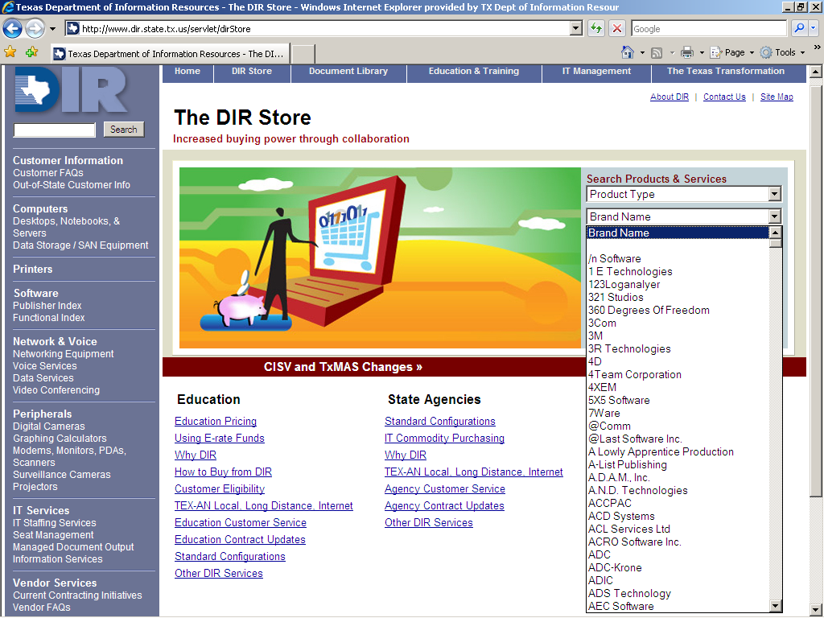
Searchable by Brand Name

Slide 28
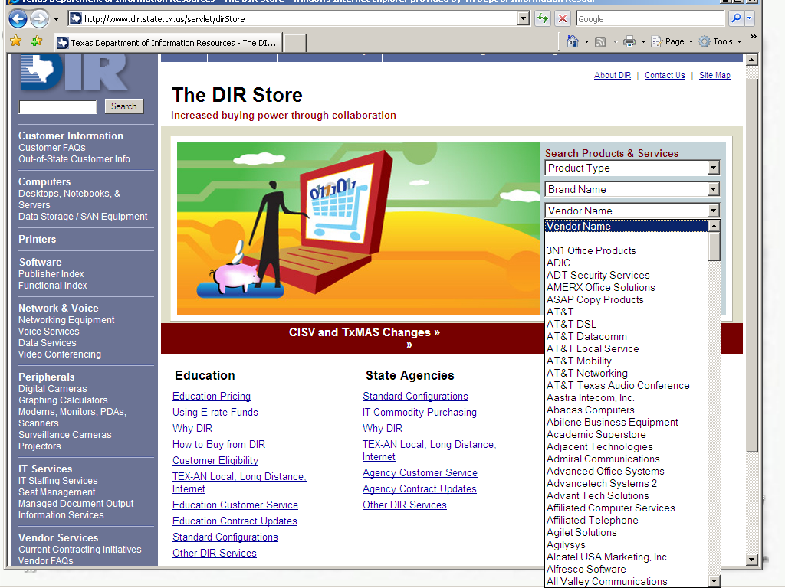
Searchable by Vendor Name

Slide 29
Questions
Sherri Parks
Director
Contracting & Procurement Services
(512) 463-3580
sherri.parks@dir.state.tx.us
www.dir.state.tx.us

